Slide 1
Introduction to the Roman Empire
A Brief Overview of the Ancient Roman Empire

Slide 2
Foundation of the Roman Empire
The Roman Empire was founded in 27 BCE by Augustus Caesar after the end of the Roman Republic.
Augustus established a centralized imperial government that would last for centuries and influence Western civilization.
The empire expanded through military conquest and diplomatic negotiations, encompassing lands from Europe to North Africa and the Middle East.

Slide 3
Government and Administration
The Roman Empire had a complex system of government and administration.
At the top was the emperor, who held absolute power and was considered a god-like figure.
Below the emperor were governors, senators, and other officials who managed various regions and oversaw legal and administrative matters.

Slide 4
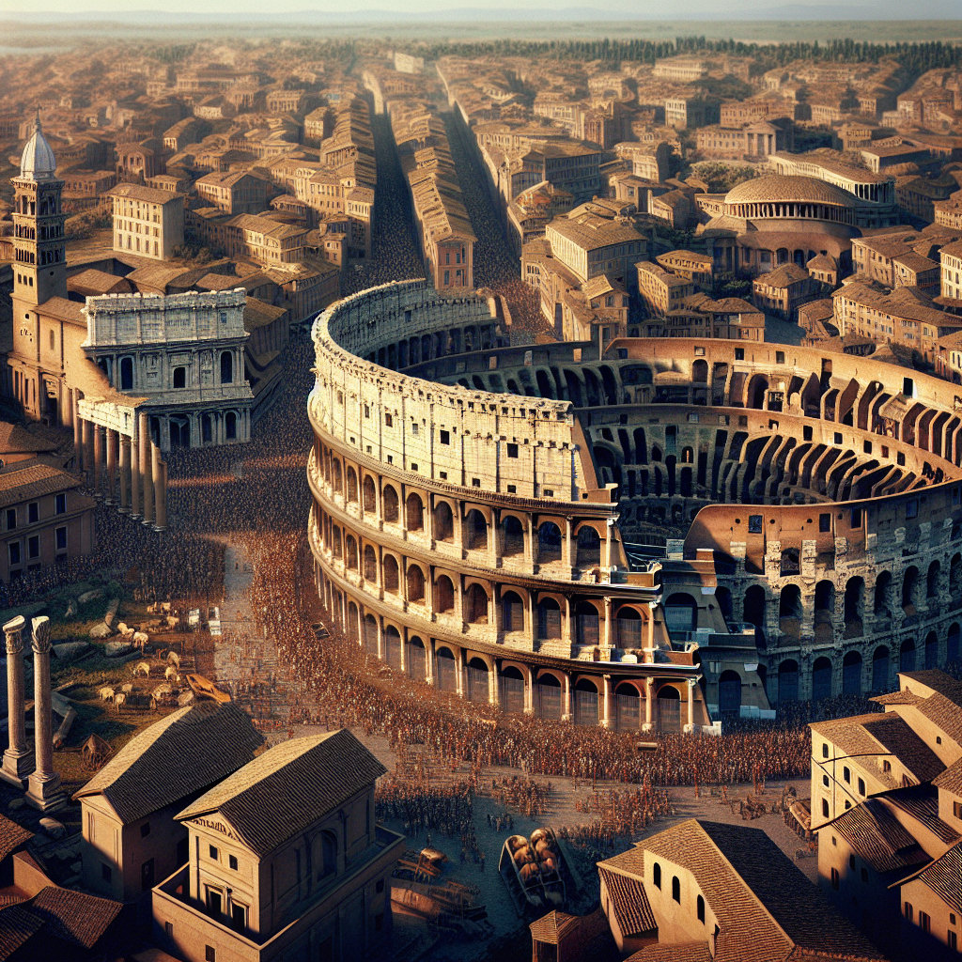
Roman Architecture
Roman architecture is known for its grandeur and innovative engineering.
The Romans built iconic structures such as the Colosseum and the Pantheon, showcasing their mastery of arches, vaults, and concrete.
These architectural achievements continue to inspire and influence modern architecture.
Roman Architecture

Slide 5
Roman Culture and Society
Roman culture was influenced by Greek, Etruscan, and other Mediterranean civilizations.
The Romans excelled in literature, art, philosophy, and engineering.
They enjoyed gladiator games, chariot races, and elaborate public spectacles.

Slide 6
Roman Achievements and Contributions
The Roman Empire made significant contributions to various fields.
In law, the Romans developed the concept of written legal codes and the principle of innocent until proven guilty.
They also made advancements in engineering, including the construction of aqueducts, roads, and bridges.

Slide 7
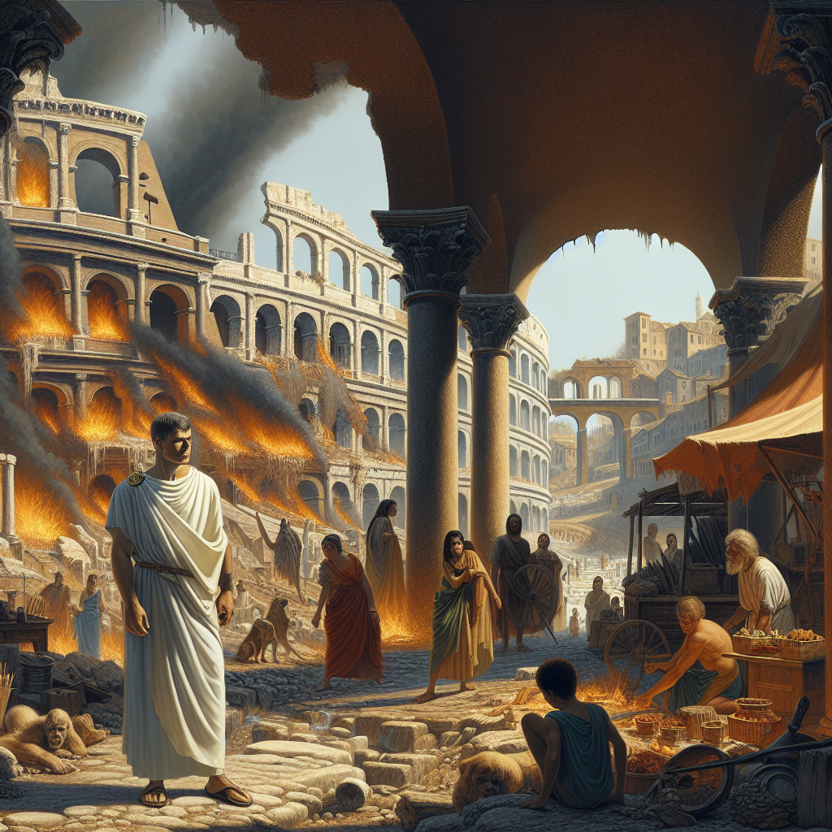
Decline and Fall of the Roman Empire
The Roman Empire faced numerous challenges that led to its decline and eventual fall.
Internal conflicts, economic instability, and invasions by barbarian tribes weakened the empire.
The fall of the Western Roman Empire in 476 CE marked the end of ancient Rome and the beginning of the Middle Ages.
Fall of the Roman Empire

Slide 8
Legacy of the Roman Empire
The Roman Empire left an enduring legacy in many aspects of modern life.
Roman law influenced legal systems in Europe and beyond.
Roman architecture, literature, and philosophy continue to inspire and shape our culture and society.

Slide 9
References
1. Beard, M. (2015). SPQR: A history of ancient Rome. Profile Books.
2. Grant, M. (1978). The history of Rome. Faber and Faber.
3. Kamm, A. (2008). The Romans: An introduction (2nd ed.). Routledge.

Slide 10
Thank You
Thank you for your attention!
Any questions?

